Slide 1


Department of Mechanical Engineering
Six-Month Industry Internship Seminar-I
Session: 2026-2027
Date:18/08/2026
Industry Name: Lemken India Agro Equipment Pvt Ltd
Project: Industrial Energy Monitoring & Analytics System (IIOT)
Presented By:
Name: Jayant Subhash Kurekar
Roll No. : 20
Section: A
Department: Mechanical Engineering
Batch: A5
Guide Name: Dr. Rupesh Shelke
Designation: Head Of Department, Mechanical Engineering
GHRCE, Nagpur
Industry Guide:
Mr. Nishant Ganorkar
Designation: Plant Maintenance Head

Slide 2


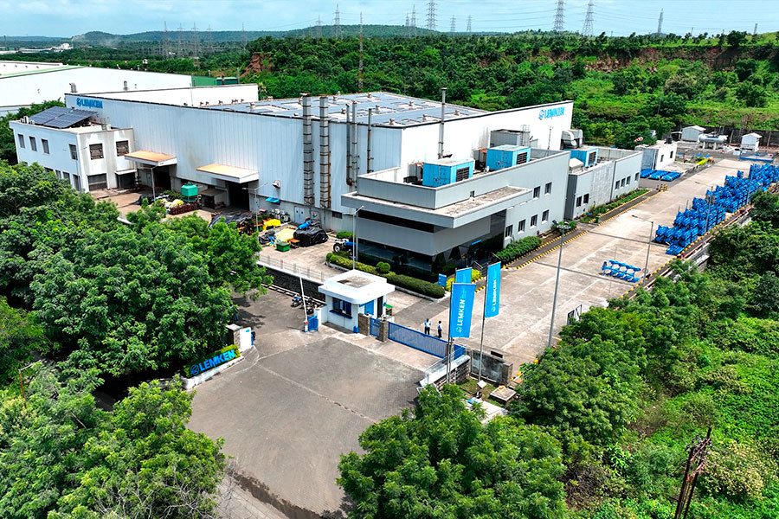
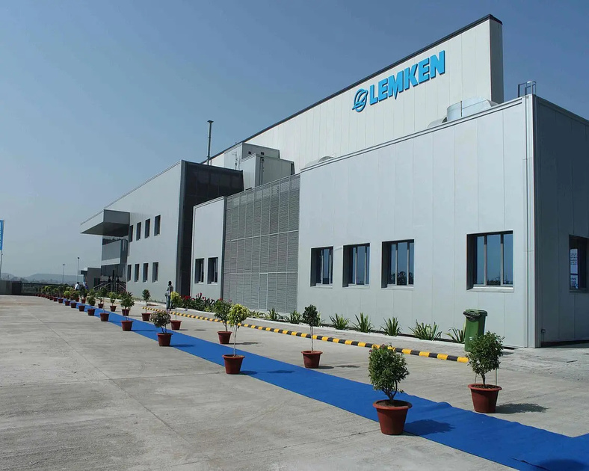
Industry Description
About the Industry: LEMKEN operates in the agricultural machinery and farm mechanization industry. It manufactures advanced agricultural implements such as ploughs, cultivators, power harrows, mulchers, and subsoilers.
Historical Background: LEMKEN was founded in 1780 in Germany and has over 245 years of experience in agricultural technology. LEMKEN India was incorporated in 2010 as a subsidiary of LEMKEN GmbH and began manufacturing in Nagpur.

Slide 3
Industry Description
Vision: To become India’s most respected premier agricultural implement manufacturer by providing quality products and excellent customer service.
Mission: To improve farmers’ productivity and income through reliable, durable and user-friendly mechanized agricultural solutions
Location: D-59, MIDC, Butibori, Nagpur, Maharashtra – 44110
Annual Turnover: 130 Crores
Number of Employees: 200-300
Products:
Juwel 6 M & Opal Series – Reversible Ploughs
Achat 70 & Kyanite 7 – Tyne Cultivators
Perlite 5 – Power Harrow
Melior – Subsoiler
Spinel – Mulcher
Mentor Details:
Name: Mr. Nishant Ganorkar
Phone No.: 95452 78822
Email ID: n.ganorkar@lemken.com
HR Details:
Name: Mr. Shripad Takalkar
Phone No.: 93222 84849
Email ID: S.Takalkar@lemken.com

Slide 4
Problem Identification
The Need for Smarter Industries:
As technology moves toward greater efficiency, accuracy, and automation, industries need to evolve beyond conventional mechanical systems. Mechanical power alone is no longer enough - the integration of IoT, electronics, software, and AI can bring the next level of industrial intelligence.
The Idea Behind IEMAS:
During my internship interview, I was asked whether energy monitoring across the plant could be automated. My answer was a confident “Yes.” This led to the idea of developing a system that could automate data collection, reduce manual calculations, and make energy consumption easier to understand through visualization and analytics.
Industry Challenges:
Manual Calculations – Energy readings and consumption calculations require manual effort.
Limited Data Visualization – No centralized dashboard to easily understand energy trends and patterns.
Limited Accessibility – Energy data is not easily accessible from a centralized location when required.
Data Privacy & Security – Sensitive industrial data should not be exposed to external AI services.
Private AI Requirement – An organization-specific/private LLM layer can provide AI insights while maintaining data confidentiality and company policies.
“If we can automate production, why should energy monitoring remain manual?”

Slide 5
Project Description
IEMAS - Industrial Energy Monitoring & Analytics System (IIOT)
OBJECTIVE
SCOPE
To develop an IoT-based system for real-time monitoring and analysis of industrial energy consumption.
To collect meter readings through RS485 Modbus, store them securely, and visualize machine-wise and PMCC-wise consumption.
To use AI insights to identify abnormal consumption, energy waste, and opportunities for reduction.
To create a scalable solution for plant-wide energy monitoring.
To Help Industry to save on Energy Bills by optimizing energy planning.
Access to Historical data in visualized formats.
Monitor energy consumption from industrial energy meters and collect readings through an edge device.
Provide a web dashboard with live data, historical trends, machine-wise/PMCC-wise analysis, and reports.
Enable future expansion to multiple meters, plant-wide monitoring, alerts, predictive insights, and industrial-system integration.
BENEFITS
Reduces manual meter checking and dependency on handwritten records.
Helps quickly identify high energy consumption, idle loads, abnormal spikes, and energy wastage.
Enables data-driven decisions, better energy management, and potential reduction in operating costs.

Slide 6

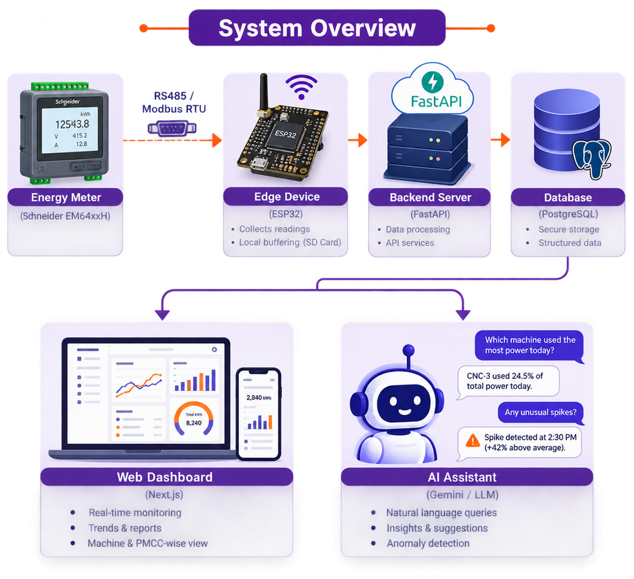
Abstract
Industrial Energy Monitoring & Analytics System (IEMAS) is an IoT-based solution designed to centralize and simplify industrial energy monitoring. The system collects energy readings from industrial meters using RS485 Modbus communication, stores the data, and presents it through a web-based dashboard. AI-powered insights help users understand consumption patterns and identify potential energy wastage.
Expected Impact:
Reduced manual effort
Faster identification of energy wastage
Better data-driven energy management
Key Highlights:
Real-time Energy Monitoring from industrial meters
Machine & PMCC-wise Analysis through interactive dashboards
Historical Data & Reports for energy consumption tracking
AI-powered Insights for trends and abnormal consumption
Local Data Buffering when internet connectivity is unavailable
Scalable Architecture for future plant-wide deployment

Slide 7
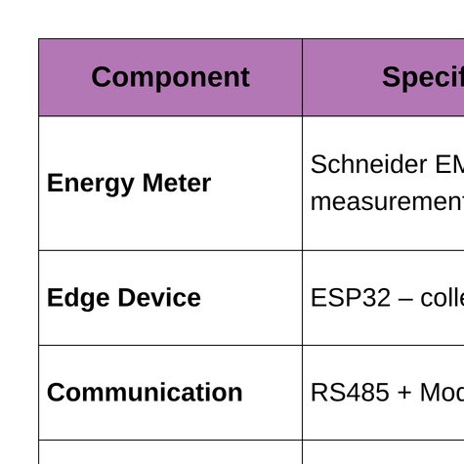
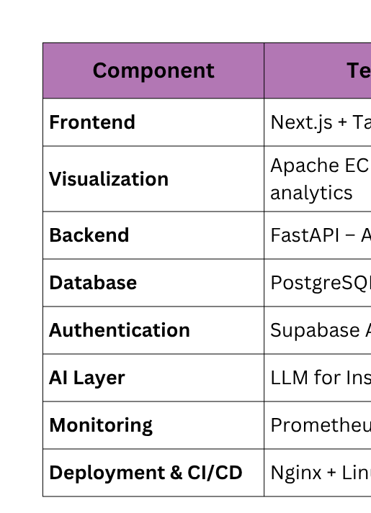
Hardware & Software Specification
Hardware Specifications
Software Specifications

Slide 8
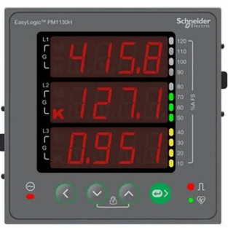
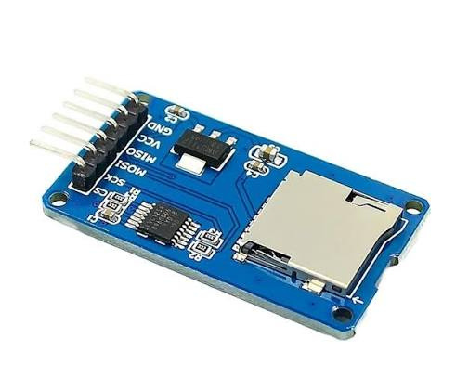
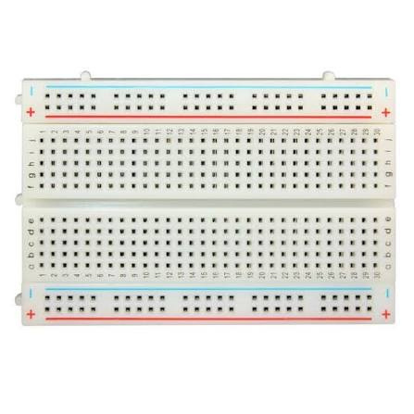
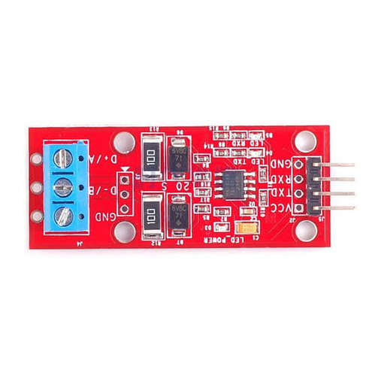
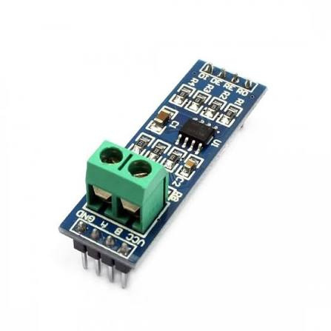
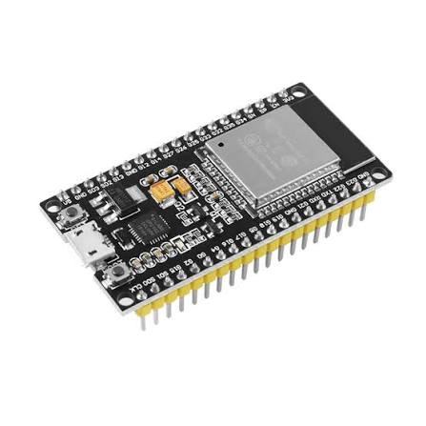
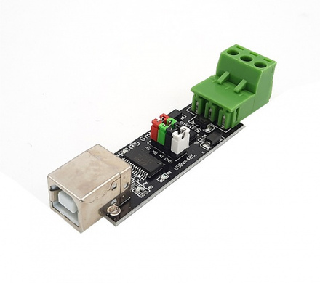
Hardware Components
Bread board
Schneider Electric
EM64xxH series meter
SD card Module
ESP32 Devkit v1
Microcontroller
Max485 to ttl converter
Automatic
Max485 to Usb Converter
Max485 to ttl converter
Manual

Slide 9
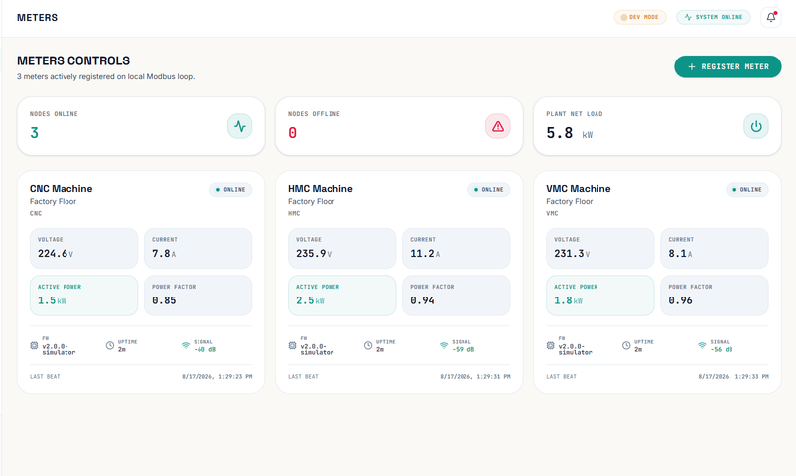
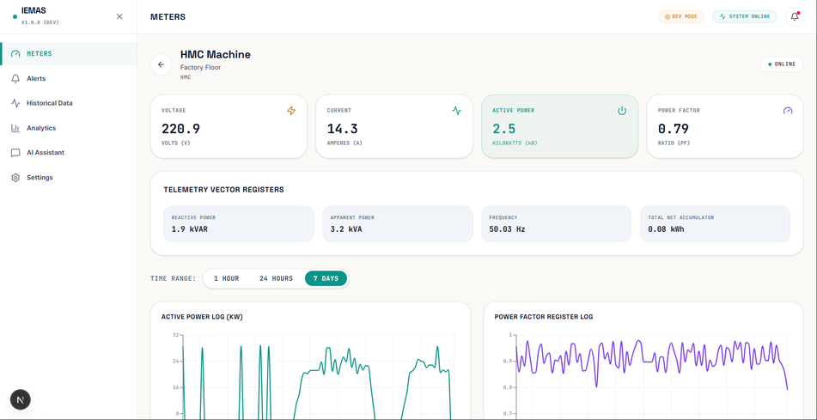
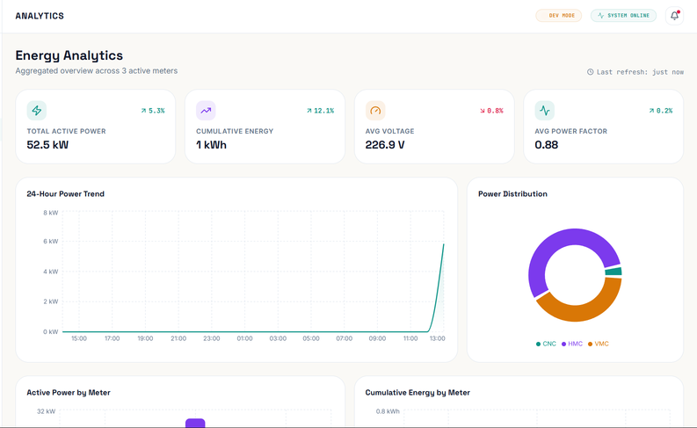
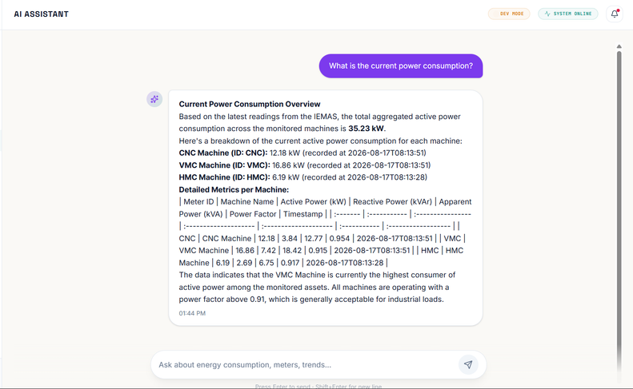
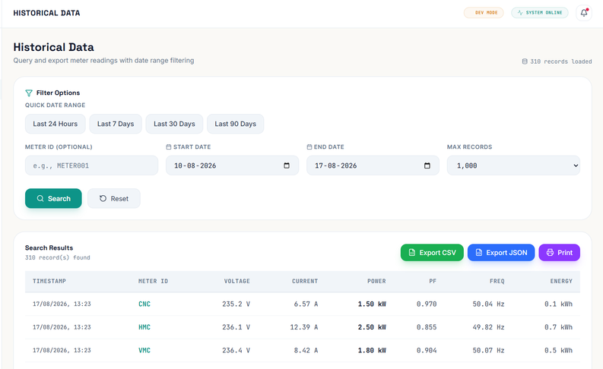
Software Overview
Dashboard
Meter Overview
Analytics page
AI Assistant
Historical Data Access

Slide 10

Thank You!

